Slide 1
UNIT-1
ELECTRIC HEATING

Slide 2
Electric heating is extensively used both for domestic and industrial applications.
Domestic applications include (i) room heaters (ii) immersion heaters for water heating (iii) hot plates for cooking (iv) electric kettles (v) electric irons (vi) pop-corn plants (vii) electric ovens for bakeries and (viii) electric toasters etc.
Industrial applications of electric heating include (i) melting of metals (ii) heat treatment of metals like annealing, tempering, soldering and brazing etc. (iii) moulding of glass (iv) baking of insulators (v) enamelling of copper wires etc.

Slide 3
Advantages of Electric Heating
As compared to other methods of heating using gas, coal and fire etc., electric heating is far superior for the following reasons:
Cleanliness: Since neither dust nor ash is produced in electric heating, it is a clean system of heating requiring minimum cost of cleaning. Moreover, the material to be heated does not get contaminated.
(ii) No Pollution: Since no flue gases are produced in electric heating, no provision has to be made for their exit.
(iii) Economical: Electric heating is economical because electric furnaces are cheaper in their initial cost as well as maintenance cost since they do not require big space for installation or for storage of coal and wood. Moreover, there is no need to construct any chimney or to provide extra heat installation.
.

Slide 4
(iv) Ease of Control. It is easy to control and regulate the temperature of an electric furnace with the help of manual or automatic devices. Temperature can be controlled within ± 5°C which is not possible in any other form of heating
(v) Special Heating Requirement. Special heating requirements such as uniform heating of a material or heating one particular portion of the job without affecting its other parts or heating with no oxidation can be met only by electric heating.
(vi) Higher Efficiency. Heat produced electrically does not go away waste through the chimney and other by-products. Consequently, most of the heat produced is utilised for heating the material itself. Hence, electric heating has higher efficiency as compared to other types of heating.
(vii) Better Working Conditions. Since electric heating produces no irritating noises and also the radiation losses are low, it results in low ambient temperature. Hence, working with electric furnaces is convenient and cool.
(viii) Heating of Bad Conductors. Bad conductors of heat and electricity like wood, plastic and bakery items can be uniformly and suitably heated with dielectric heating process.
(ix) Safety. Electric heating is quite safe because it responds quickly to the controlled signals.
(x) Lower Attention and Maintenance Cost. Electric heating equipment generally will not require much attention and supervision and their maintenance cost is almost negligible. Hence, labour charges are negligibly small as compared to other forms of heating.

Slide 5
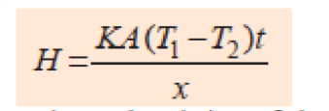
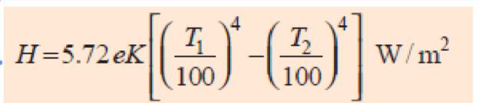
Different Methods of Heat Transfer
The different methods by which heat is transferred from a hot body to a cold body are as under:
Conduction is the transfer of thermal energy through direct contact.
Convection is the transfer of thermal energy through the movement of a liquid or gas. The rate of heat emission is given by Stefan‘s law according to which Heat dissipated
Radiation is the transfer of thermal energy through thermal emission.

Slide 6
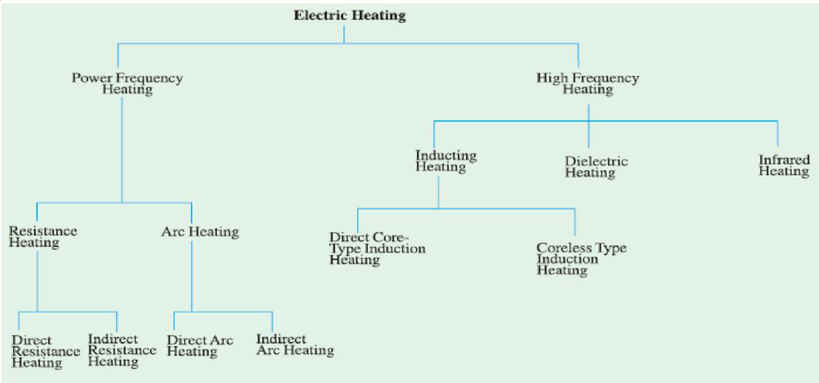

Slide 7
Resistance Heating
It is based on the I²R effect. When current is passed through a resistance element I²R loss takes place which produces heat.
There are two methods of resistance heating.
(a) Direct Resistance Heating. In this method the material (or charge) to be heated is treated as a resistance and current is passed through it. The charge may be in the form of powder, small solid pieces or liquid. The two electrodes are inserted in the charge and connected to either a.c. or d.c. supply (Fig. 1). Obviously, two electrodes will be required in the case of d.c. or single-phase a.c. supply but there would be three electrodes in the case of 3-phase supply. When the charge is in the form of small pieces, a powder of high resistivity material is sprinkled over the surface of the charge to avoid direct short circuit. Heat is produced when current passes through it. This method of heating has high efficiency because the heat is produced in the charge itself.

Slide 8
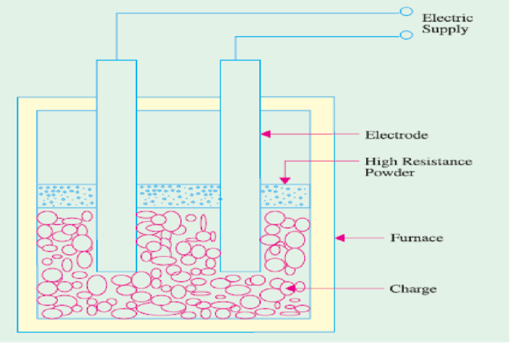
Automatic stirring action is produced in the charge to be heated and no external method of stirring is required to get uniform heating.
Fig 1. Direct Resistance Heating

Slide 9
Indirect Resistance Heating. In this method of heating, electric current is passed through a resistance element which is placed in an electric oven.
Heat produced is proportional to I2R losses in the heating element. The heat so produced is delivered to the charge either by radiation or convection or by a combination of the two.
Sometimes, resistance is placed in a cylinder which is surrounded by the charge placed in the jacket as shown in the Fig 2. This arrangement provides uniform temperature. Moreover, automatic temperature control can also be provided.

Slide 10
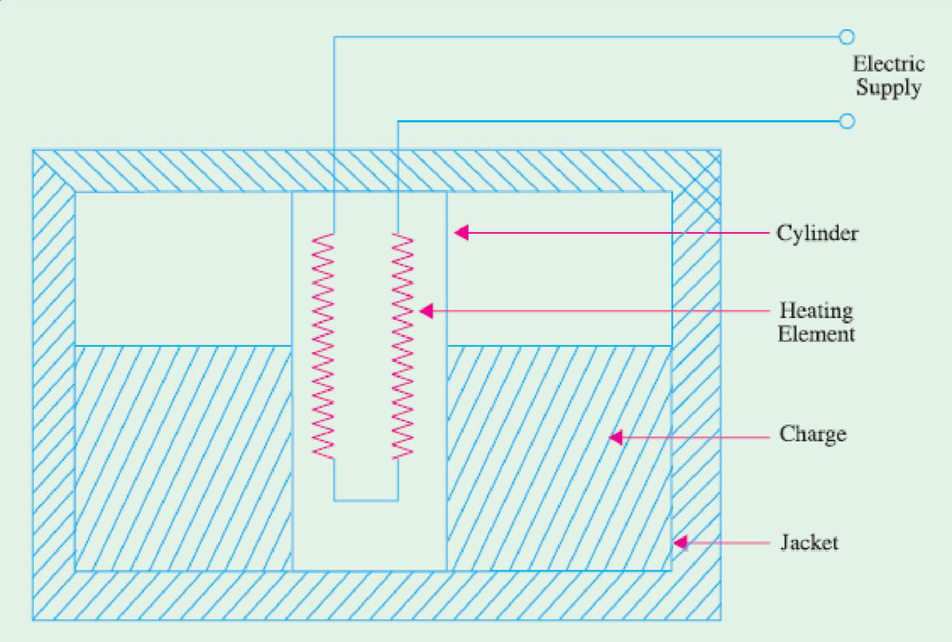
Fig. Indirect Resistance Heating

Slide 11
Overall efficiency of Resistance heating is high and resistance heating method gives good load factor and almost Unity Power Factor.
Examples of Direct Resistance Heating:
Salt bath Furnaces
Electrode boiler for water heater
Examples of Indirect Resistance Heating:
Room Heater
Hair Drier
Soldering Iron
Immersion Heater Electric Oven

Slide 12
Requirement of a Good Heating Element
Indirect resistance furnaces use many different types of heating elements for producing heat. A good heating element should have the following properties :
(1) High Specific Resistance. When specific resistance of the material of the wire is high, only short length of it will be required for a particular resistance (and hence heat) or for the same length of the wire and the current, heat produced will be more.
(2) High Melting Temperature. If the melting temperature of the heating element is high, it would be possible to obtain higher operating temperatures.
(3) Low Temperature Coefficient of Resistance. In case the material has low temperature coefficient of resistance, there would be only small variations in its resistance over its normal range of temperature. Hence, the current drawn by the heating element when cold (i.e., at start) would be practically the same when it is hot.
(4) Oxidising Temperature. Oxidisation temperature of the heating element should be high in order to ensure longer life.

Slide 13
(5) Positive Temperature Coefficient of Resistance. If the temperature coefficient of the resistance of heating element is negative, its resistance will decrease with rise in temperature and it will draw more current which will produce more wattage and hence heat. With more heat, the resistance will decrease further resulting in instability of operation.
(6) Ductile. Since the material of the heating elements has to have convenient shapes and sizes, it should have high ductility and flexibility.
(7) Mechanical Strength. The material of the heating element should posses high mechanical strength of its own. Usually, different types of alloys are used to get different operating temperatures. For example maximum working temperature of constant an (45% Ni, 55% Cu) is 400°C, that of nichrome (50%, Ni 20% Cr) is 1150°C, that of Kantha (70% Fe, 25% Cr, 5% Al) is 1200° C and that of silicon carbide is 1450°C.

Slide 14
Some of the factors responsible for failure of heating element are :
(1) Formation of hot spots which shine brighter during operation
(2) Oxidation
(3) Corrosion
(4) Mechanical failure

Slide 15
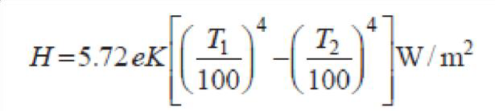
Design of Heating Element
Normally, wires of circular cross-section or rectangular conducting ribbons are used as heating elements.
Under steady-state conditions, a heating element dissipates as much heat from its surface as it receives the power from the electric supply.
If P is the power input and H is the heat dissipated by radiation, then P = H under steady-state conditions.
As per Stefan‘s law of radiation, heat radiated by a hot body is given by
where T1 is the temperature of hot body in °K and T2 that of the cold body (or cold surroundings) in °K

Slide 16
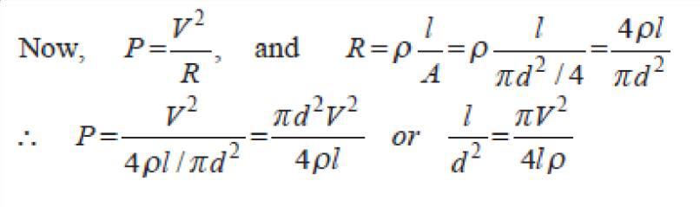
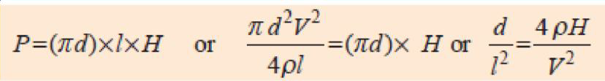
Total surface area of the wire of the element = (Πd) × l………………………………(i)
If H is the heat dissipated by radiation per second per unit surface area of the wire, then
heat radiated per second = (Πd) × l × H……………(ii)
Equating (i) and (ii), we have

Slide 17
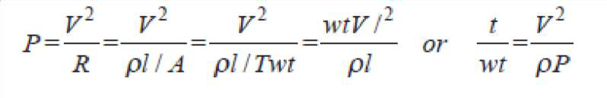
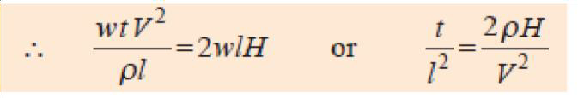
We can find the values of l and d from Eq. (i) and (iii) given above.
Ribbon Type Element
If w is the width of the ribbon and t its thickness, then
……………(iv)
Heat lost from ribbon surface = 2wl H (neglecting the side area 2tl )
……………(v)
Values of l and w for a given ribbon of thickness t can be found from Eqn. (iv) and (v) given above.

Slide 18
Problem on Design of heating element done in the class

Slide 19
Electric Arc Furnace Working Principle
The electric arc furnace working principle is based on the heat generated by an electric arc.
The electric arc heating may be used in the following different ways.
There are two types of arc furnaces namely:
1.Direct Electric Arc Furnace
2. Indirect Electric Arc Furnace
By striking the arc between the charge and electrode: In this method, the heat is directly conducted and taken by the charge. The furnaces operating on this principle are known as direct arc furnace. These furnaces are used for production and refining of various grade of steel.
By striking the arc between two electrodes: In this method, the heat is transferred to the charge by radiations. The furnaces operating on this principle are known as indirect arc furnaces. These types of furnaces are used for melting of non-ferrous metals such as brass, copper and zinc.

Slide 20
Power Supply for Electric Arc Furnace
The power consumption of the arc furnaces is very high.
The arc voltage is low i.e. between 50-150 V but the current required is of the order of several hundred amperes.
As the heating effect is proportional to the square of the current, therefore, the higher current is essential to achieve the higher temperature.
For obtaining the required power supply a 3-phase arc furnace transformer is used.
When the electrodes are short-circuited, the total input to the furnace is almost zero. On the other hand, when the electrodes are far away , arc is extinguished and there is no power drawn from the supply mains.

Slide 21
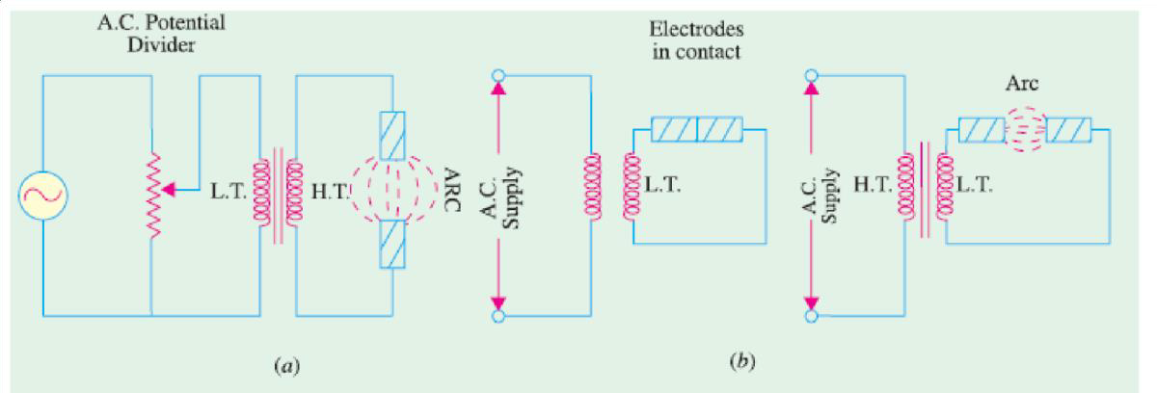
If a sufficiently high voltage is applied across an air-gap, the air becomes ionized and starts conducting in the form of a continuous spark or arc thereby producing intense heat. When electrodes are made of carbon/graphite, the temperature obtained is in the range of 3000°C-3500C. The high voltage required for striking the arc can be obtained by using a step-up transformer fed from a variable a.c. supply as shown in Fig (a).

Slide 22
An arc can also be obtained by using low voltage across two electrodes initially in contact with each other as shown in Fig. (b).
The low voltage required for this purpose can be obtained by using a step-down transformer.
Initially, the low voltage is applied, when the two electrodes are in contact with each other. Next, when the two electrodes are gradually separated from each other, an arc is established between the two.

Slide 23
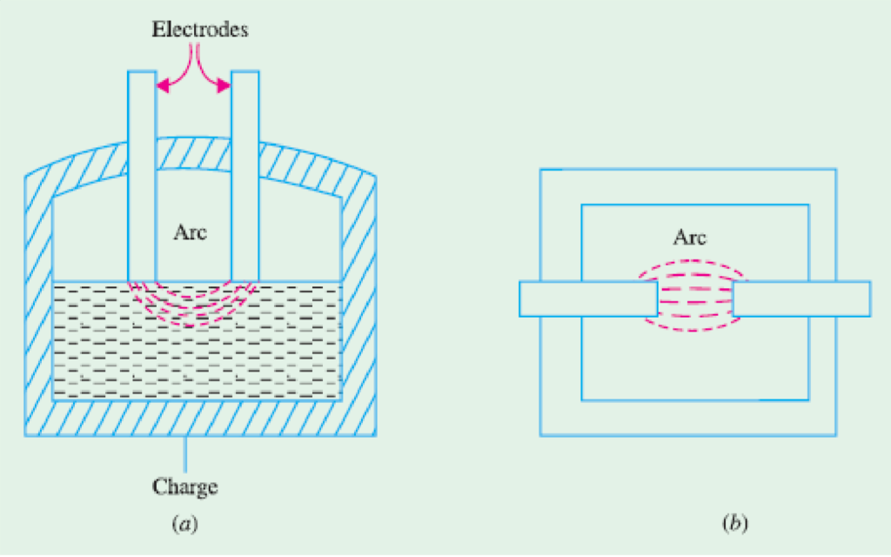
Arc furnaces can be of the following two types :
1. Direct Arc Furnace
In this case, arc is formed between the two electrodes and the charge in such a way that electric current passes through the body of the charge as shown in Fig. (a). Such furnaces produce very high temperatures.
2. Indirect Arc Furnace
In this case, arc is formed between the two electrodes and the heat thus produced is passed on to the charge by radiation as shown in Fig. (b).

Slide 24
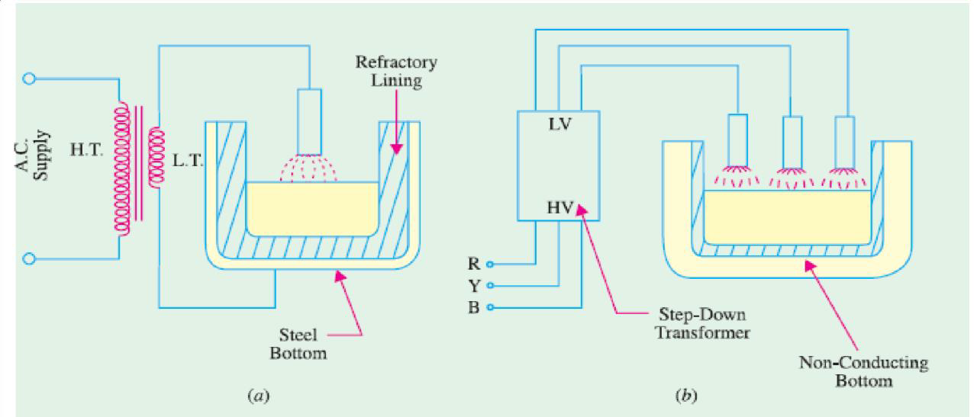
It could be either of conducting-bottom type [Fig. (a)] or non-conducting bottom type [Fig. (b)].
Most common application of these furnaces is in the production of steel because of the ease with which the composition of the final product can be controlled during refining.
Most of the furnaces in general use are of non-conducting bottom type due to insulation problem faced in case of conducting bottom.

Slide 25
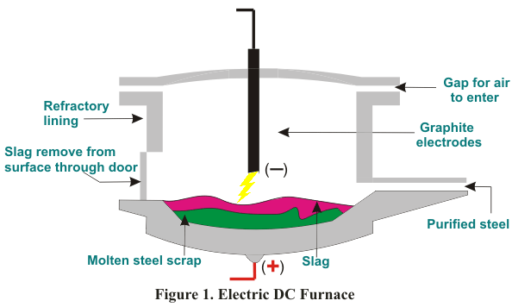
Direct Arc Furnace

Slide 26
Arc Volt ampere characteristics, stable zone and unstable zone , condition for Maximum output power loss in the Arc Furnace
and
P.F of arc furnace circuit
discussed in the class

Slide 27
Refractory linings of Electric Arc Furnaces are made generally of resin-bonded magnesia carbon bricks.
When the bricks are heated the bonding material is coked and turns into a carbon network binding the refractory grains, preventing wetting by the slag and protecting the lining from the erosion and chemical attack of the molten metal and slag.

Slide 28
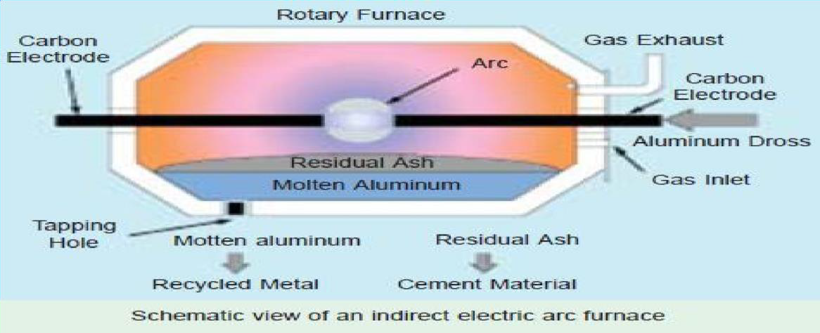
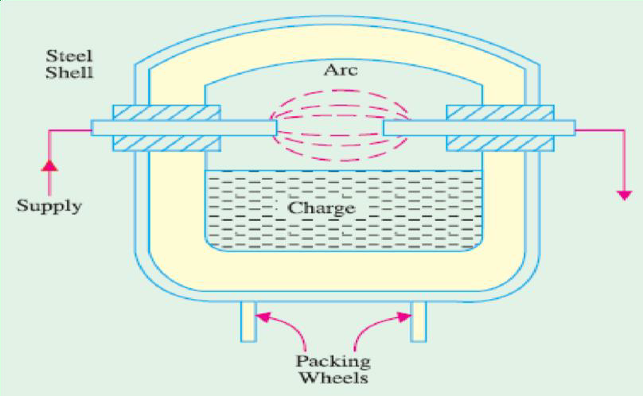
Indirect Arc Furnace

Slide 29
Fig. shows a single-phase indirect arc furnace which is cylindrical in shape. The arc is struck by short circuiting the electrodes manually or automatically for a moment and then, withdrawing them apart.
The heat from the arc and the hot refractory lining is transferred to the top layer of the charge by radiation. The heat from the hot top layer of the charge is further transferred to other parts of the charge by conduction. Since no current passes through the body of the charge, there is no inherent stirring action due to electro-magnetic forces set up by the current.
Hence, such furnaces have to be rocked continuously in order to distribute heat uniformly by exposing different layers of the charge to the heat of the arc. An electric motor is used to operate suitable grinders and rollers to impart rocking motion to the furnace. Rocking action provides not only thorough mixing of the charge, it also increases the furnace efficiency in addition to increasing the life of the refractory lining material. Since in this furnace, charge is heated by radiation only, its temperature is lower than that obtainable in a direct arc furnace.
Such furnaces are mainly used for melting nonferrous metals although they can be used in iron foundaries where small quantities of iron are required frequently.

Slide 30
Induction Heating
Low frequency induction furnaces employed for the melting of metals are of the following two types :
Core-type Furnaces — which operate just like a two winding transformer. These can be further sub-divided into (i) Direct core-type furnaces (ii) Vertical core-type furnaces and (iii) Indirect core-type furnaces.
(b) Coreless-type Furnaces — in which an inductively-heated element is made to transfer heat to the charge by radiation.

Slide 31
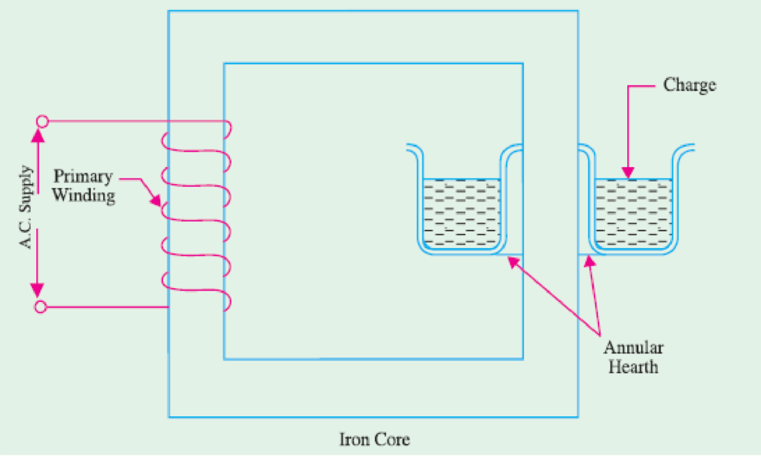
Direct Core Type Induction Furnace

Slide 32
Direct Core Type Induction Furnace
It is shown in Fig. and is essentially a transformer in which the charge to be heated forms a single-turn short-circuited secondary and is magnetically coupled to the primary by an iron core. The furnace consists of a circular hearth which contains the charge to be melted in the form of an annular ring. When there is no molten metal in the ring, the secondary becomes open-circuited there-by cutting off the secondary current. Hence, to start the furnace, molted metal has to be poured in the annular hearth.
Since, magnetic coupling between the primary and secondary is very poor, it results in high leakage and low power factor. In order to nullify the effect of increased leakage reactance, low primary frequency of the order of 10 Hz is used.
If the transformer secondary current density exceeds 500 A/cm² then, due to the interaction of secondary current with the alternating magnetic field, the molten metal is squeezed to the extent that secondary circuit is interrupted. This effect is known as ―pinch effect.

Slide 33
Vertical Core-Type Induction Furnace
It is also known as Ajax-Wyatt furnace and represents an improvement over the core-type furnace.
As shown in Fig., it has vertical channel (instead of a horizontal one) for the charge, so that the crucible used is also vertical which is convenient from metallurgical point of view. In this furnace, magnetic coupling is comparatively better and power factor is high.
Hence, it can be operated from normal frequency supply. The circulation of the molten metal is kept up round the Vee portion by convection currents as shown in Fig. . As Vee channel is narrow, even a small quantity of charge is sufficient to keep the secondary circuit closed. However, Vee channel must be kept full of charge in order to maintain continuity of secondary circuit. This fact makes this furnace suitable for continuous operation. The tendency of the secondary circuit to rupture due to pinch-effect is counteracted by the weight of the charge in the crucible. The choice of material for inner lining of the furnace depends on the type of charge used. Clay lining is used for yellow brass. For red brass and bronze, an alloy of magnetia and alumina or corundum is used. The top of the furnace is covered with an insulated cover which can be removed for charging. The furnace can be tilted by the suitable hydraulic arrangement for taking out the molten metal.
This furnace is widely used for melting and refining of brass and other non-ferrous metals. As said earlier, it is suitable for continuous operation. It has a p.f. of 0.8-0.85. With normal supply frequency, its efficiency is about 75% and its standard size varies from 60-300 kW, all single-phase.

Slide 34
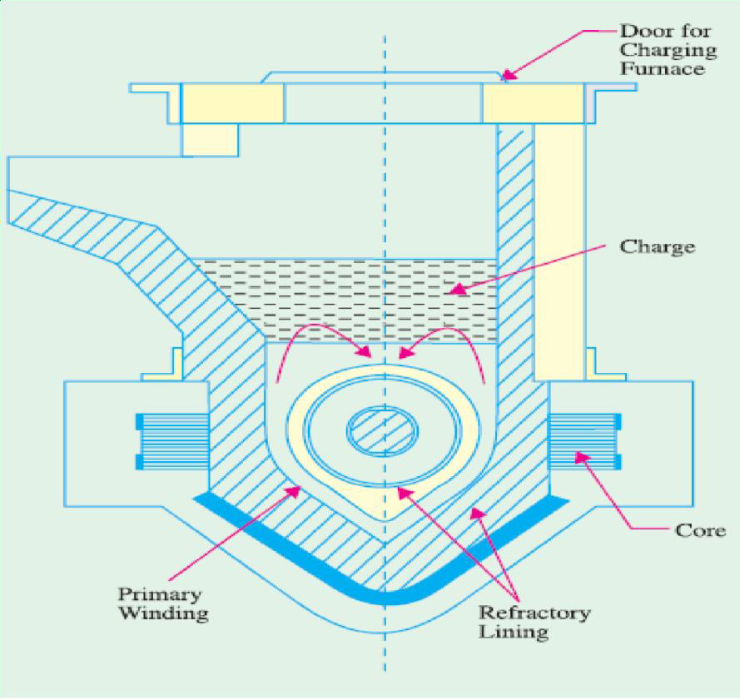

Slide 35
Indirect Core-Type Induction Furnace
In this furnace, a suitable element is heated by induction which, in turn, transfers the heat to the charge by radiation.
As shown in Fig. the secondary consists of a metal container which forms the walls of the furnace proper. The primary winding is magnetically coupled to this secondary by an iron core. When primary winding is connected to a.c. supply, secondary current is induced in the metal container by transformer action which heats up the container. The metal container transfers this heat to the charge. A special advantage of this furnace is that its temperature can be automatically controlled without the use of an external equipment. The part AB of the magnetic circuit situated inside the oven chamber consists of a special alloy which loses its magnetic properties at a particular temperature but regains them when cooled back to the same temperature. As soon as the chamber attains the critical temperature, reluctance of the magnetic circuit increases manifold thereby cutting off the heat supply. The bar AB is detachable and can be replaced by other bars having different critical temperatures.

Slide 36
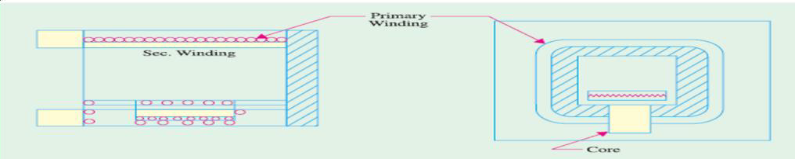

Slide 37
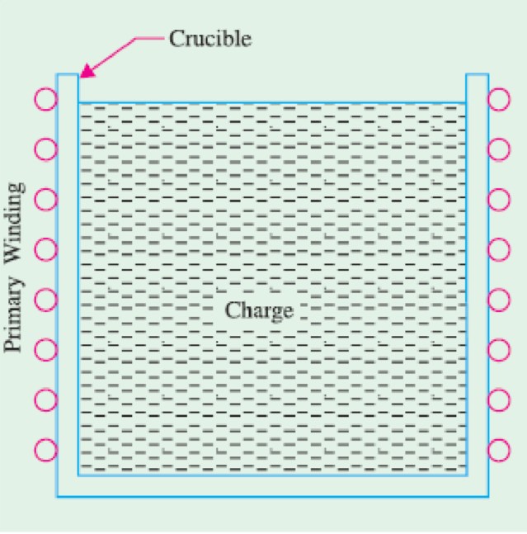
Coreless Induction Furnace
Three main parts of the furnace are
primary coil
a ceramic crucible containing charge which forms the secondary and
the frame which includes supports and tilting mechanism.

Slide 38
The distinctive feature of this furnace is that it contains no heavy iron core with the result that there is no continuous path for the magnetic flux. The crucible and the coil are relatively light in construction and can be conveniently tilted for pouring.
The charge is put into the crucible and primary winding is connected to a high-frequency a.c. supply.
The flux produced by the primary sets up eddy-currents in the charge and heats it up to the melting point. The charge need not be in the molten state at the start as was required by core-type furnaces.

Slide 39
The eddy- currents also set up electromotive forces which produce stirring action which is essential for obtaining uniforms quality of metal. Since flux density is low (due to the absence of the magntic core) high frequency supply has to be used because eddy-current loss(We). However, this high frequency increases the resistance of the primary winding due to skin effect, thereby increasing primary Cu losses.
Hence, the primary winding is not made of Cu wire but consists of hollow Cu tubes which are cooled by water circulating through them. Since magnetic coupling between the primary and secondary windings is low, the furnace p.f. lies between 0.1 and 0.3. Hence, static capacitors are invariably used in parallel with the furnace to improve its p.f.

Slide 40
These are used for steel production and for melting of non-ferrous metals like brass, bronze, copper and aluminium etc., along with various alloys of these elements.
Special application of these furnaces include vacuum melting, melting in a controlled atmosphere and melting for precision casting where high frequency induction heating is used. It also finds wide use in electronic industry and in other industrial activities like soldering, brazing hardening and annealing and sterilizing surgical instruments etc.

Slide 41
Advantages of coreless Induction furnaces
(1) They are fast in operation.
(2) They produce most uniform quality of product.
(3) They can be operated intermittently.
(4) Their operation is free from smoke, dirt, dust and noises.
(5) They can be used for all industrial applications requiring heating and melting.
(6) They have low erection and operating costs.
(7) Their charging and pouring is simple.

Slide 42
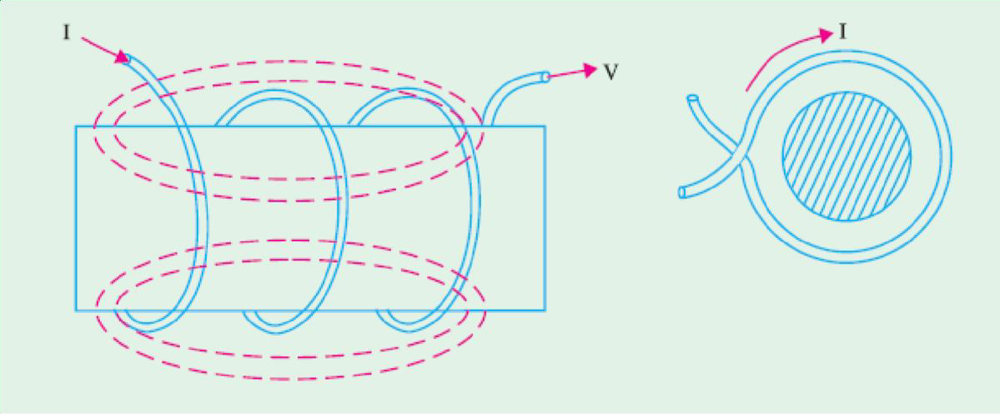
High Frequency Eddy-current Heating
For heating an article by eddy-currents, it is placed inside a high frequency a.c. current-carrying coil (Fig. ). The alternating magnetic field produced by the coil sets up eddy-currents in the article which, consequently, gets heated up. Such a coil is known as heater coil or work coil and the material to be heated is known as charge or load. Primarily, it is the eddy-current loss which is responsible for the production of heat although hysteresis loss also contributes to some extent in the case of non-magnetic materials.

Slide 43
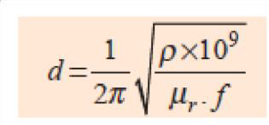
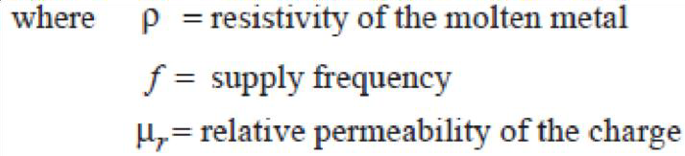
The eddy-current loss
We α B²f²
Hence, this loss can be controlled by controlling flux density B and the supply frequency ƒ.
This loss is greatest on the surface of the material but decreases as we go deep inside. The depth of the material upto which the eddy-current loss penetrates is given by

Slide 44
Advantages of Eddy-current Heating
(1) There is negligible wastage of heat because the heat is produced in the body to be heated.
(2) It can take place in vacuum or other special environs where other types of heating are not possible.
(3) Heat can be made to penetrate any depth of the body by selecting proper supply frequently.
Applications of Eddy-current Heating
(1) Surface Hardening. The bar whose surface is to be hardened by heat treatment is placed within the working coil which is connected to an a.c. supply of high frequency. The depth upto which the surface is to be hardened can be obtained by the proper selection of frequency of the coil current. After a few seconds, when surface has reached the proper temperature, a.c. supply is cut off and the bar is at once dipped in water.
(2) Annealing. Normally, annealing process takes long time resulting in scaling of the metal which is undesirable. However, in eddy-current heating, time taken is much less so that no scale formation takes place.
(3) Soldering. Eddy-current heating is economical for precise high-temperature soldering where silver, copper and their alloys are used as solders.

Slide 45
Dielectric Heating
It is also called high-frequency capacitative heating and is used for heating insulators like wood, plastics and ceramics etc. which cannot be heated easily and uniformly by other methods.
The supply frequency required for dielectric heating is between 10-50 MHz and the applied voltage is upto 20 kV.
The overall efficiency of dielectric heating is about 50%.

Slide 46
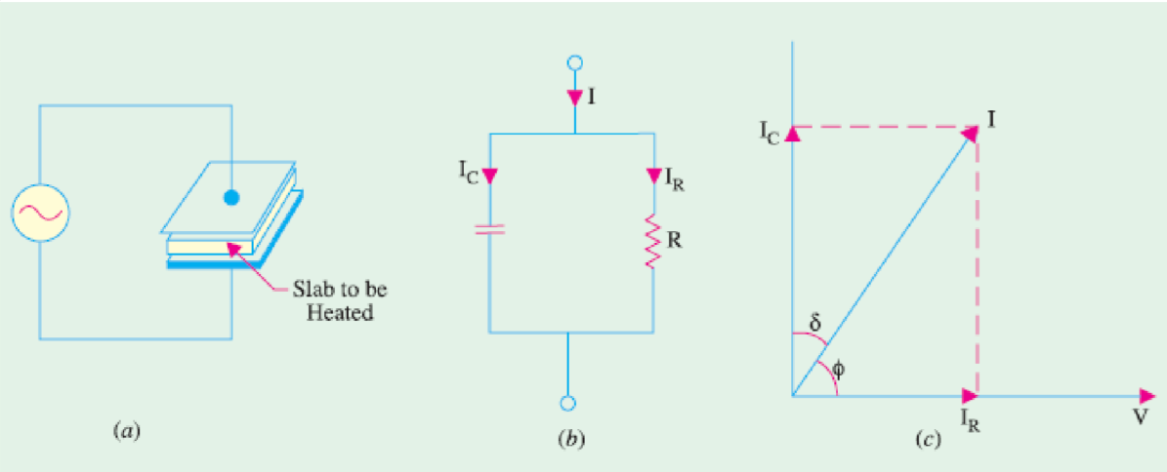

Slide 47
When a practical capacitor is connected across an a.c. supply, it draws a current which leads the voltage by an angle , which is a little less than 90° or falls short of 90° by an angle δ.
It means that there is a certain component of the current which is in phase with the voltage and hence produces some loss called dielectric loss.
At the normal supply frequency of 50 Hz, this loss is negligibly small but at higher frequencies of 50 MHz or so, this loss becomes so large that it is sufficient to heat the dielectric in which it takes place.
The insulating material to be heated is placed between two conducting plates in order to form a parallel-plate capacitor as shown in Fig.

Slide 48
P = 2 f C V²cos ɸ

Slide 49
Advantages of Dielectric Heating
1. Since heat is generated within the dielectric medium itself, it results in uniform heating.
2. Heating becomes faster with increasing frequency.
3. It is the only method for heating bad conductors of heat.
4. Since no flame appears in the process, inflammable articles like plastics and wooden products etc., can be heated safely.
6. Heating can be stopped immediately as and when desired

Slide 50
Applications of Dielectric Heating
Since cost of dielectric heating is very high, it is employed where other methods are not possible or are too slow. Some of the applications of dielectric heating are as under:
For gluing of multilayer plywood boards.
2. For baking of sand cores which are used in the moulding process.
3. For preheating of plastic compounds before sending them to the moulding section.
4. For drying of tobacco after glycerine has been mixed with it for making cigarattes.
5. For baking of biscuits and cakes etc. in bakeries with the help of automatic machines.
6. For electronic sewing of plastic garments like raincoats etc. with the help of cold rollers fed with high-frequency supply.
7. For dehydration of food which is then sealed in air-tight containers.
8. For removal of moistures from oil emulsions.
9. In diathermy for relieving pain in different parts of the human body.

